Slide 1
South Midlands
The Labour Market
January 2025

Slide 2
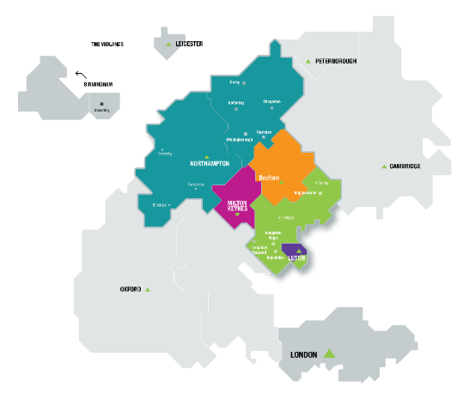
Introduction
South Midlands comprises:
Bedfordshire
Luton
Milton Keynes
Northamptonshire
Our role is to help economic growth thrive across the South Midlands by supporting job creation, a pipeline of talented people and skills development for the future prosperity of the local communities.

Slide 3
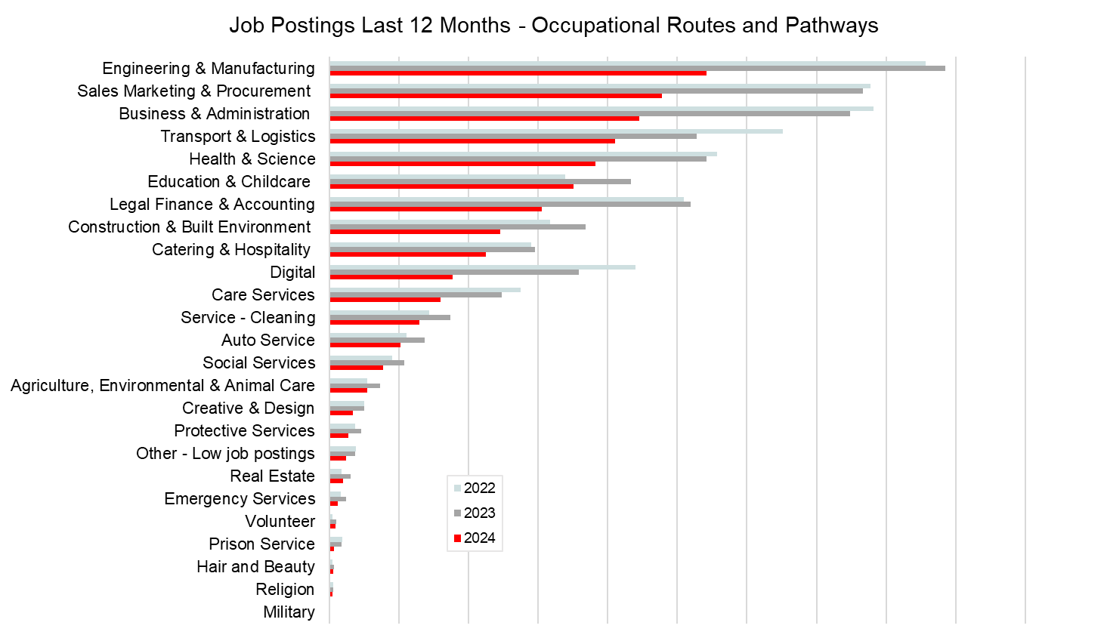
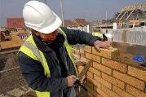
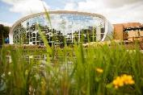
Top occupational groups in demand now
Source: Lightcast

Slide 4
“Employability Skills”
Attitudes & Behaviours
Core Transferable Skills
Technical & Vocational
Work ethic
Detail orientated
Willingness to learn
Enthusiasm
Self-motivation
Independent working
Flexibility/Adaptability
Honesty
Reliability
Politeness
Humility
Empathy
Curiosity
Expressing yourself/Active listening
Organisation
Digital literacy/Interaction with computers
Planning
Problem solving
Decision making
Creativity/Innovation
Leadership/Developing Teams
Time management
Analysing/Evaluating
Teamwork
Collaboration
Resilience
Job specific
Science, Technology, Engineering, Art and Maths (STEAM)
Specialist digital skills
Education
Commercial acumen
Financial awareness
Customer service
Sales
Management
Working with hands
Driving
Basic Skills
Qualifications & Certifications
Literacy
Numeracy
English
Basic digital
Technical Qualifications
Academic Qualifications
Technical Certification
Vocational Certification
Source: Local Skills Improvement Plan
Source: Local Skills Improvement Plan

Slide 5
Future opportunities
New Jobs and Changes in Occupation Roles
Automation driven service industries
Digital
Engineering and technology
Education
Health
Care
Net Zero/Green Economy/Sustainability
Scientific research
Engineering and technology
Machine operators/technicians
Agriculture
Regulatory professionals
Population Serving
Health
Care
Education

Slide 6
Other Sources of Information
Explore your education and training choices at Skills for Careers – https://www.skillsforcareers.education.gov.uk/pages/young-people
Explore careers at:
National Careers Service - https://nationalcareers.service.gov.uk/explore-careers
Prospects – Information on jobs, work experience and pathways https://www.prospects.ac.uk/jobs-and-work-experience/job-sectors/
Youth Employment Careers and pathways into work https://www.youthemployment.org.uk/careers-hub/
icould – video and careers information - https://icould.com/explore/categories/job-types/#jobtype
South East Midlands Careers Hub - Careers Advice & Applications

Slide 7
Other Sources of Information
Explore occupational groups with need locally
Engineering - This is Engineering - An introduction to the sector and the opportunities it offers https://www.thisisengineering.org.uk/
Construction - GoConstruct, the construction industry guide to careers https://www.goconstruct.org/
Manufacturing - Makeuk, what is it like to work in UK manufacturing -https://www.makeuk.org/insights/blogs/what-is-it-like-to-work-in-uk-manufacturing
Creative Industries - Creative Industries Federation, discover creative careers https://discovercreative.careers/#/
Health - NHS Find Your Career https://www.healthcareers.nhs.uk/FindYourCareer, MK, Bedfordshire, Luton https://work-learn-live-blmk.co.uk/jobs/, Northamptonshire https://bestofbothworlds.uk.net/
Care - Think Care Careers, Skills for Care https://www.skillsforcare.org.uk/Careers-in-care/Think-Care-Careers.aspx,
Logistics and Supply Chain - Transport & Logistics careers - https://generationlogistics.org/
Digital - Digital World - https://www.digitalworld.net/industries-and-jobs
Hospitality (Food and Accommodation) - https://nationalcareers.service.gov.uk/job-categories/hospitality-and-food

