Slide 1
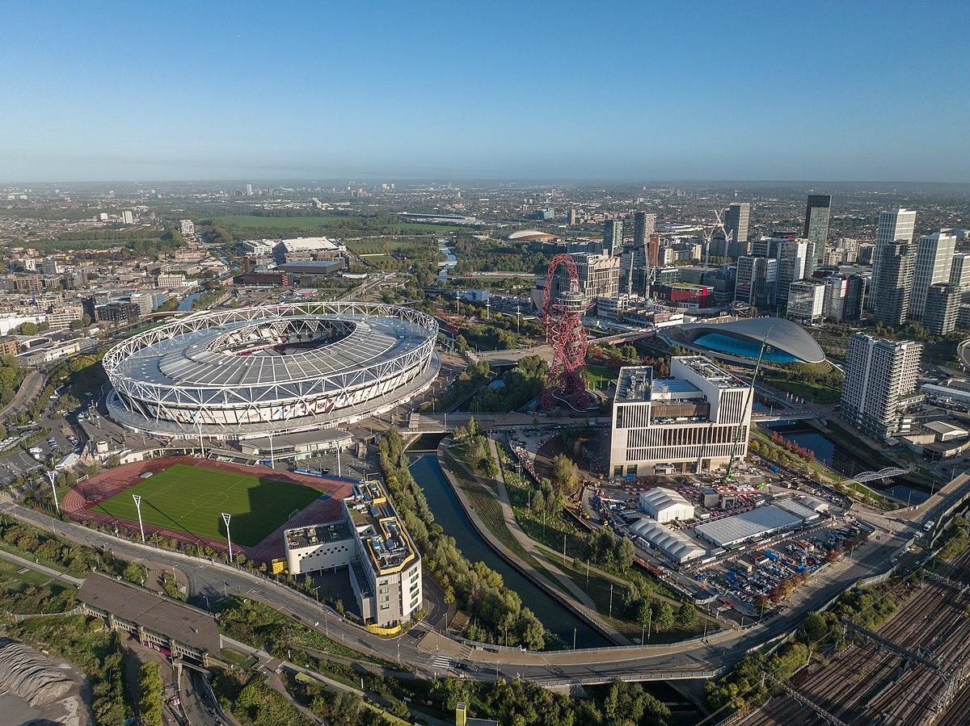
AQA GCSE Geography
Paper 3: Geographical applications
Human Geography Fieldwork
NAME: _________________________________

Slide 2
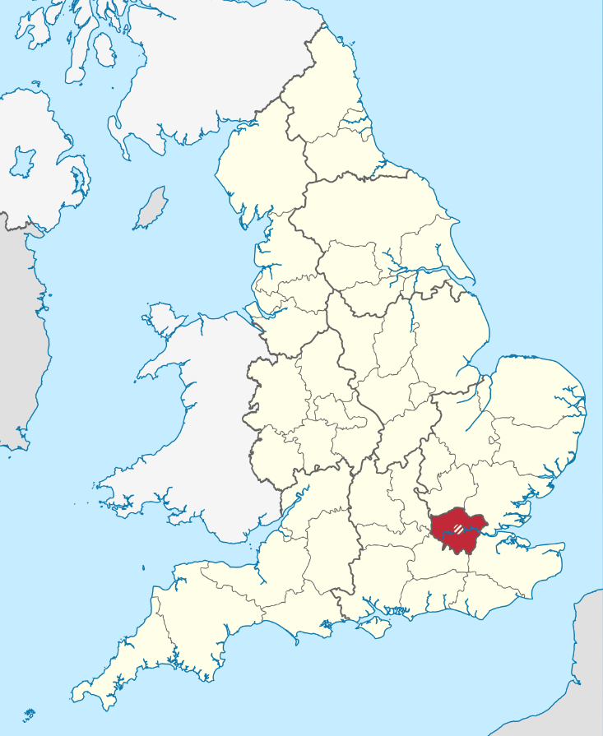
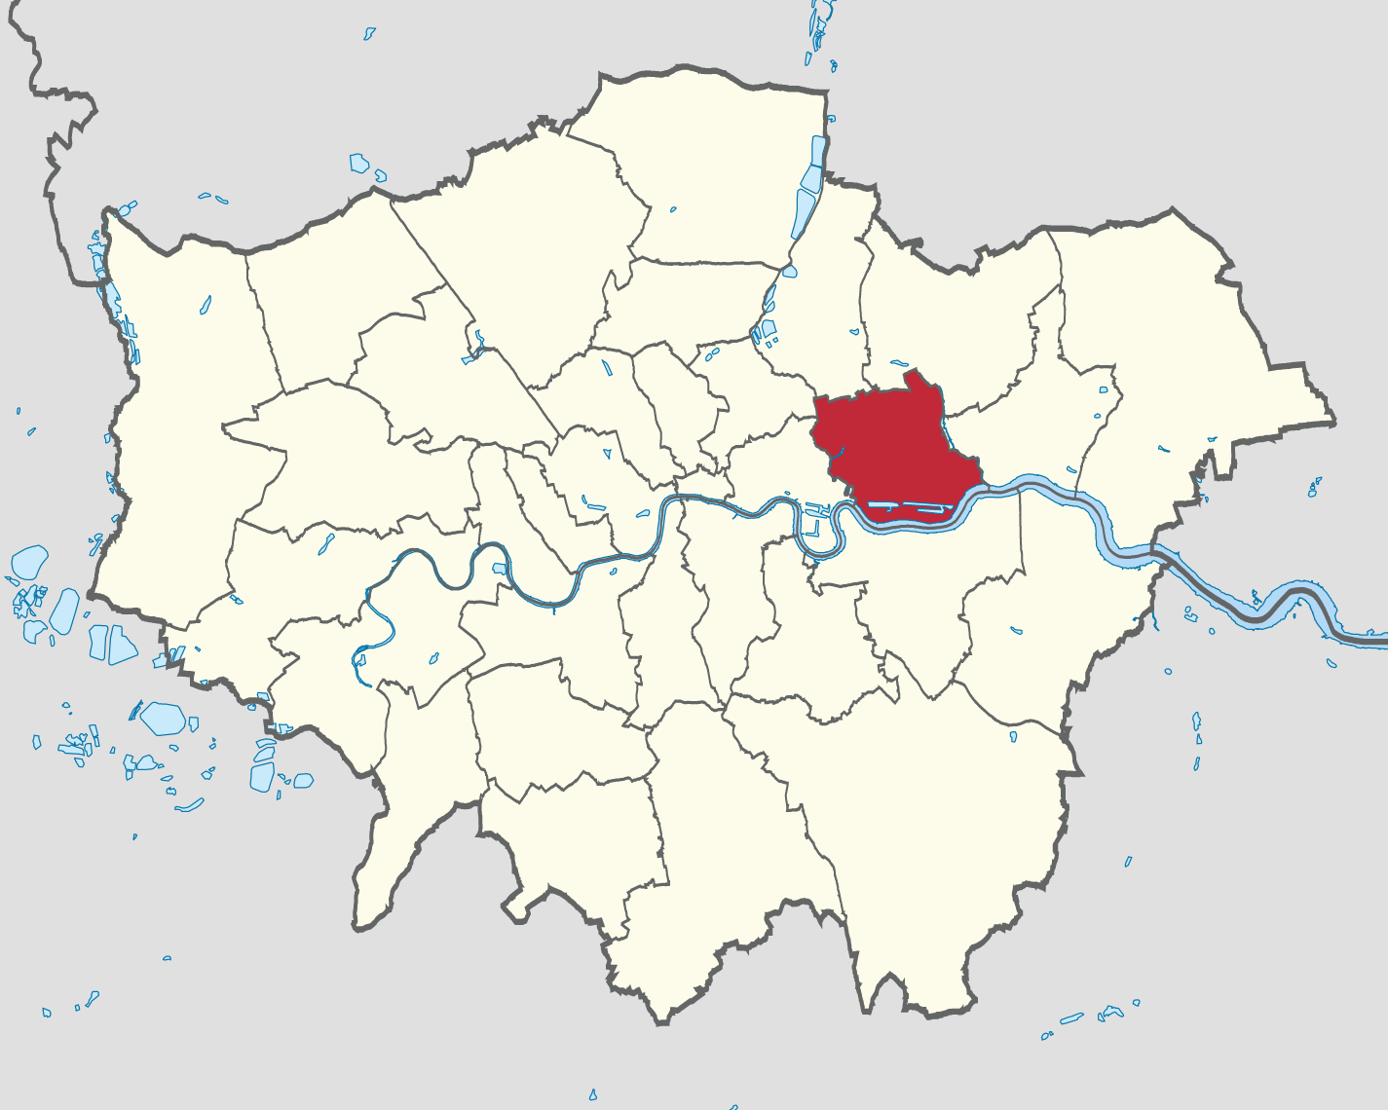
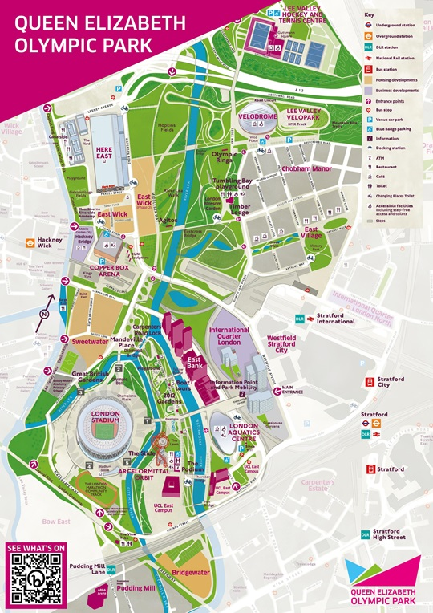
Where is our study site?
Milton Keynes
Describe the location of the Queen Elizabeth Olympic Park.
______________________________________________________________________________________________________________________________________________________________________________________________________________________________________________________________________________________________________________________________________________________________________________________________________________________________________________________________________________________________________________________________________________________________________________________________________________________________________________________________________________________________________________________________

Slide 3
Why is the Olympic Park a suitable location to study?
Title of fieldwork enquiry: The regeneration of Stratford has improved the urban sustainability of the local area.
Our human geography enquiry takes place in the Queen Elizabeth Olympic Park, in the London Borough of Newham.
The area has undergone an extensive period of urban regeneration, catalysed by the London 2012 Olympic Games. The area was previously industrial with many factories and warehouses that closed in the 1970s & 1980s leading to deindustrialisation, and a spiral of decline.
The regeneration has changed the land use of the area and has improved quality of life. We are still able to visit Stratford High Street to view a non-regenerated area close by.
Suggest one reason why the chosen location was suitable for data collection in your human geography enquiry. (2 marks)
You should mention one reason why the location is suitable to study and briefly explain how this makes it suitable. This could be linked to location, or it could be linked to how it meets the title of your fieldwork enquiry.
____________________________________________________________________________________________________________________________________________________________________________________________________________________________________________________________________________________________________________________________________
/2
If you did not achieve full marks, use red pen to write an EBI of how you could improve your answer below.
__________________________________________________________________________________________________________________________________________________________________

Slide 4
Why is the Olympic Park a suitable location to study?
Title of fieldwork enquiry: The regeneration of Stratford has improved the urban sustainability of the local area.
Write definitions for the key-terms below.
Urban regeneration: ___________________________________ _____________________________________________________ _____________________________________________________
Spiral of decline:_______________________________________ _____________________________________________________ _____________________________________________________
Sustainability:_________________________________________ _____________________________________________________ _____________________________________________________
Complete the table showing the social, economic and environmental issues associated with a spiral of decline.
Social | Economic | Environmental

Slide 5
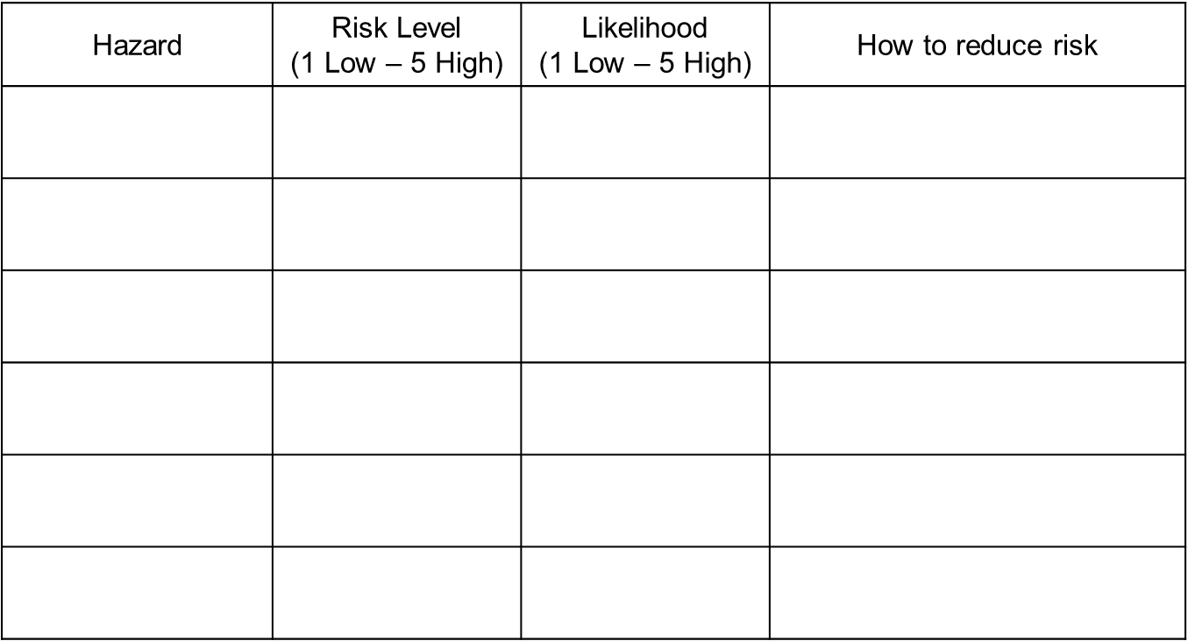
How can we manage risk?
Complete the risk assessment considering the risks in collecting data in Stratford.

Slide 6
What are the different types of data?
Define the 4 types of data.
Primary data: ___________________________________________ _______________________________________________________
Secondary data: ________________________________________ _______________________________________________________
Qualitative data: ________________________________________ _______________________________________________________
Quantitative data: _______________________________________ _______________________________________________________
Complete the table to show how and why each method of data could help us answer our enquiry question.
Type of data | Why would this be useful?
Primary
Secondary
Qualitative
Quantitative

Slide 7
How can we collect secondary data?
Using internet research, complete each of the boxes in as much detail as you can.
Explain the process of urban regeneration.
Why was regeneration needed in Stratford?
What has changed in Stratford as a result of the regeneration?

Slide 8
How can we collect secondary data?
What are the pros and cons of the regeneration in Stratford?
Pros | Cons
What are the social, economic and environmental impacts of the regeneration?
Social | Economic | Environmental

Slide 9
How did we decide how to collect our data?
Define the 4 types of data.
Primary data: ___________________________________________ _______________________________________________________
Secondary data: ________________________________________ _______________________________________________________
Qualitative data: ________________________________________ _______________________________________________________
Quantitative data: _______________________________________ _______________________________________________________
Define the 4 types of sampling.
Random: _______________________________________________ _______________________________________________________
Systematic: ____________________________________________ _______________________________________________________
Stratified: ______________________________________________ _______________________________________________________
Opportunistic: __________________________________________ _______________________________________________________
Which of these types of sampling did we use most? Why?
__________________________________________________________________________________________________________________________________________________________________

Slide 10
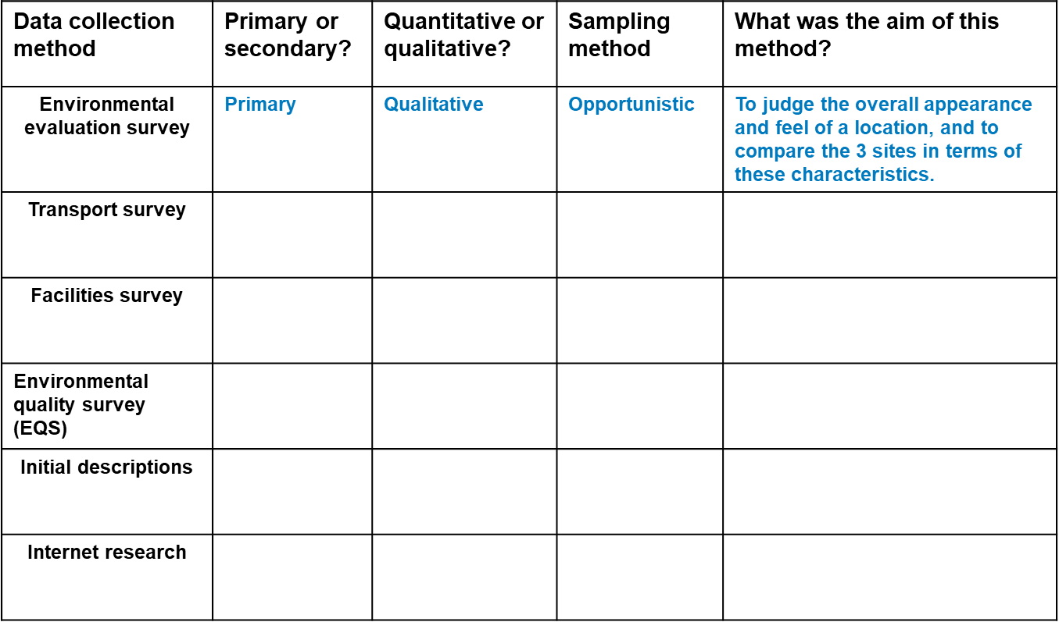
What methods did we use?
Use your booklet and experiences to complete this table to show the basic information about each data collection method.

Slide 11
Can we justify our methods of data collection?
Assess the effectiveness of your data collection method(s). (6 marks)
One primary data collection method I used was an environmental quality survey. This worked by choosing a location and completing a bi-polar scale to judge the quality of its environment, such as the condition and safety of the area. This was useful because it helped to show if the regenerated area had an improved environment compared to the unregenerated area.
This PEE paragraph would be awarded 3 marks for this exam question. Use the space below to write 2 paragraphs of your own to show the advantages of your chosen methods.
____________________________________________________________________________________________________________________________________________________________________________________________________________________________________________________________________________________________________________________________________________________________________________________________________________________________________________________________________________________________________________________________________________________________________________________________________________________________________________________________________________________________________________________________________________________________________________________________________________________________________________________________________________________________________________________________________________________________________________________________________________________________________________________________________________________________________________________________________________________________________________________________________________________________________

Slide 12
What were the limitations of our methods of data collection?
Assess the effectiveness of your data collection method(s). (6 marks)
One primary data collection method I used was an environmental quality survey. This worked by choosing a location and completing a bi-polar scale to judge the quality of its environment, such as the condition and safety of the area. This was ineffective because the scale is subjective and so the results would change depending on who was collecting the data and their opinions.
This PEE paragraph would be awarded 3 marks for this exam question. Use the space below to write 2 paragraphs of your own to show the limitations of your chosen methods.
________________________________________________________________________________________________________________________________________________________________________________________________________________________________________________________________________________________________________________________________________________________________________________________________________________________________________________________________________________________________________________________________________________________________________________________________________________________________________________________________________________________________________________________________________________________________________________________________________________________________________________________________________________________________________________________________________________________________________________________________________________________________________________________________________________________________________________________

Slide 13
How can we present our data?
The results of our EQS can be presented as a bi-polar graph. An example of this is shown below. Complete the other 2 bi-polar graphs for The Olympic Park and Stratford High Street.
A bi-polar graph showing my EQS scores for The East Village
 | -2 | -1 | 0 | 1 | 2
Design
Green Space
Condition
Natural Feel
Tidiness
Safety
Attractiveness
Traffic
Quietness
A bi-polar graph showing my EQS scores for The Olympic Park
 | -2 | -1 | 0 | 1 | 2
Design
Green Space
Condition
Natural Feel
Tidiness
Safety
Attractiveness
Traffic
Quietness
A bi-polar graph showing my EQS scores for Stratford High Street
 | -2 | -1 | 0 | 1 | 2
Design
Green Space
Condition
Natural Feel
Tidiness
Safety
Attractiveness
Traffic
Quietness

Slide 14
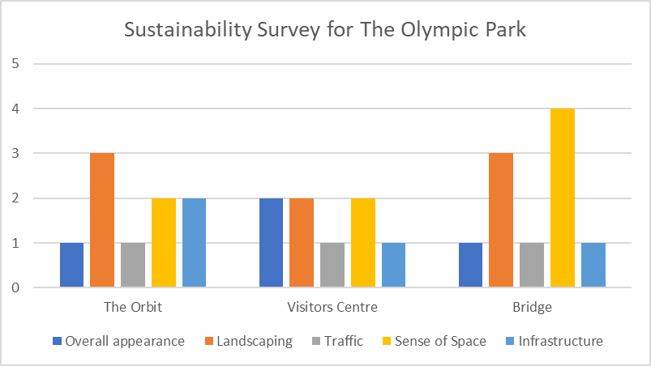
How can we present our data?
Our Sustainability Evaluation Survey can be presented as a bar chart, like the one below. On the next 2 pages draw your own bar charts for The East Village and Stratford High Street.

Slide 15

How can we present our data?
_____________________________
___________________
___________________
Key

Slide 16
How can we present our data?
_____________________________
___________________
___________________
Key

Slide 17
Can we justify our data presentation?
Complete the table to summarise the benefits of each method of data presentation.
Bi-polar graph | Bar charts
Explain how one data presentation technique used in your human geography enquiry helped you to interpret the data.
(6 marks)
One primary data presentation method I used was a bar chart. I used a bar chart to present my sustainability survey data, by plotting the scale 1-5 for each category at each location . This helped me to interpret the data because I could see the clear differences between the scores at each location, making it simple for me to see which area was the most sustainable.
This PEE paragraph would be awarded 3 marks for this exam question. Use the space on the next page to write a paragraph of your own to show the advantages of using bi-polar graphs.

Slide 18
Can we justify our data presentation?
________________________________________________________________________________________________________________________________________________________________________________________________________________________________________________________________________________________________________________________________________________________________________________________________________________________________________________________________________________________________________________________________________________________________________________________________________________________________________________________________________
________________________________________________________________________________________________________________________________________________________________________________________________________________________________________________________________________________________________________________________________________________________________________________________________________________________________________________________________________________________________________________________________________________________________________________________________________________________________________________________________________
What was challenging about this question? Use the space below to express the difficulties you faced when answering this question.
______________________________________________________________________________________________________________________________________________________________________________________________________________________________________________________________________________________________________________________________________________________________________________________________________________________________________________________________________________________________________

Slide 19
How do we analyse our data?
Analysing data involves identifying a pattern and explaining why that pattern exists.
Use the paragraph structure below to construct 2 paragraphs analysing your data sets from any method of data collection.
The data from my sustainability survey show that East Village had a sustainability score of 29 whereas Stratford High Street had a score of 61. These data can be explained because Stratford High Street had much higher traffic volume, and much less green space. These data suggest that the regeneration has made the area more sustainable because East Village was built as a result of urban regeneration and has greater amounts of green space and is much less crowded, scoring it more positively on the sustainability survey.
__________________________________________________________________________________________________________________________________________________________________________________________________________________________________________________________________________________________________________________________________________________________________________________________________________________________________________________________________________________________________________________________________________________________________________________________________________________________________________________________________________________________________________________________________________________________________________________________________________________________________________________________________________________________________________________________________________________________________________________________________________________________________________________________________

Slide 20
How do we conclude our fieldwork?
For one of your fieldwork enquiries, to what extent did your results and conclusions meet the original aim of your enquiry? (9 marks)
The aim of my enquiry was to investigate if the regeneration of Stratford has improved the urban sustainability of the local area. The results of my sustainability survey suggested that the East Village and Olympic Park were both more sustainable than Stratford high Street. I concluded this because both locations scored more positively on measures such as green space and amount of traffic, suggesting the areas are more sustainable. This conclusion meets the aim of my enquiry because it provides quantitative data that shows the level of sustainability is higher in regenerated areas than non-regenerated areas.
This PEEL paragraph would be awarded 3 marks for this exam question. Use the space below and on the next page to write 2 more paragraphs to answer this question.
________________________________________________________________________________________________________________________________________________________________________________________________________________________________________________________________________________________________________________________________________________________________________________________________________________________________________________________________________________________________________________________________________________________________________________________________________________________________________________________________________________________________________________________________________________________________________________________________________________________________________________________________________________________________

Slide 21
How do we conclude our fieldwork?
________________________________________________________________________________________________________________________________________________________________________________________________________________________________________________________________________________________________________________________________________________________________________________________________________________________________________________________________________________________________________________________________________________________________________________________________________________________________________________________________________
________________________________________________________________________________________________________________________________________________________________________________________________________________________________________________________________________________________________________________________________________________________________________________________________________________________________________________________________________________________________________________________________________________________________________________________________________________________________________________________________________
What was challenging about this question? Use the space below to express the difficulties you faced when answering this question.
______________________________________________________________________________________________________________________________________________________________________________________________________________________________________________________________________________________________________________________________________________________________________________________________________________________________________________________________________________________________________

