Slide 1




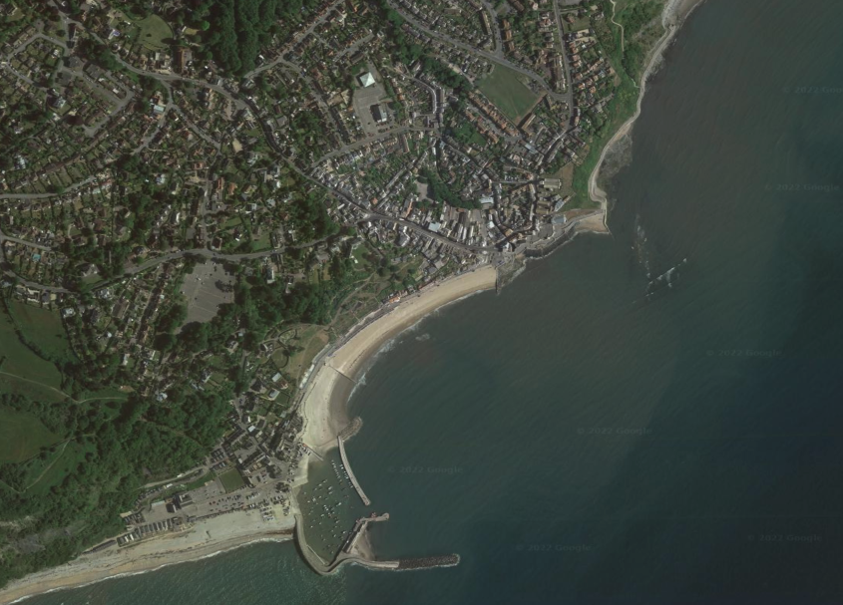

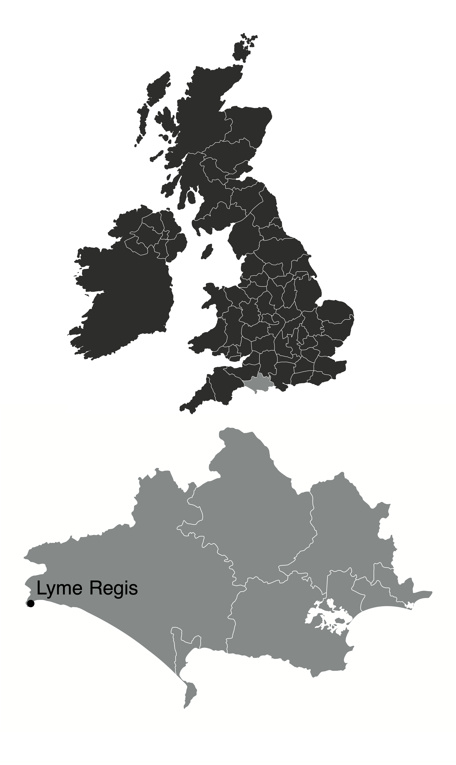

Coastal Landscapes
Lyme Regis – Coastal Management
read
quiz
The Big Picture
Management Strategy
physical processes
coastal landforms*
Nailing and drainage of the cliffs with some reprofiling to stabilise and improve drainage.
Coastal Landscapes
coastal management*
case study
New sea walls
Reason for Management
Widespread beach nourishment
Rock armour to protect the harbour wall (the Cobb) and at the eastern end of the town.
The local government developed a plan to manage the coastline at Lyme Regis called the Lyme Regis Environmental Improvement Scheme and has been completed in stages between 1990 and 2015.
Effects and Conflicts
Positive impacts
A significant improvement in the attractiveness of the seafront and beach due to nourishment and the wide promenade.
Increased visitor numbers, and seafront businesses are thriving.
The defences have withstood recent stormy winters.
The harbour is better protected, benefiting the fishing industry and boat owners.
Negative impacts
Conflicts have increased as visitor numbers have increased. Local people have experienced increased traffic congestion and litter due to increased tourism.
Some feel the new coastal defences have spoilt the natural coastal landscape.
The new defences may interfere with natural coastal processes affecting neighbouring stretches of coastline, causing conflicts elsewhere.
Stabilizing cliffs that prevent landslides will reduce the number of fossils found in the area.
Lyme Regis is a small coastal town on the south coast of England. It lies on the Jurassic Coast. The town is a popular tourist destination in the summer. The town requires coastal management because:
The coast at Lyme Regis experiences rapid erosion due to high energy waves from the south west and the weak geology of the cliffs. Therefore, houses, roads and farmland are at risk of cliff landslides.
Tourist numbers were down due to the lack of beach, with waves eroding much of the beach.

