Slide 1
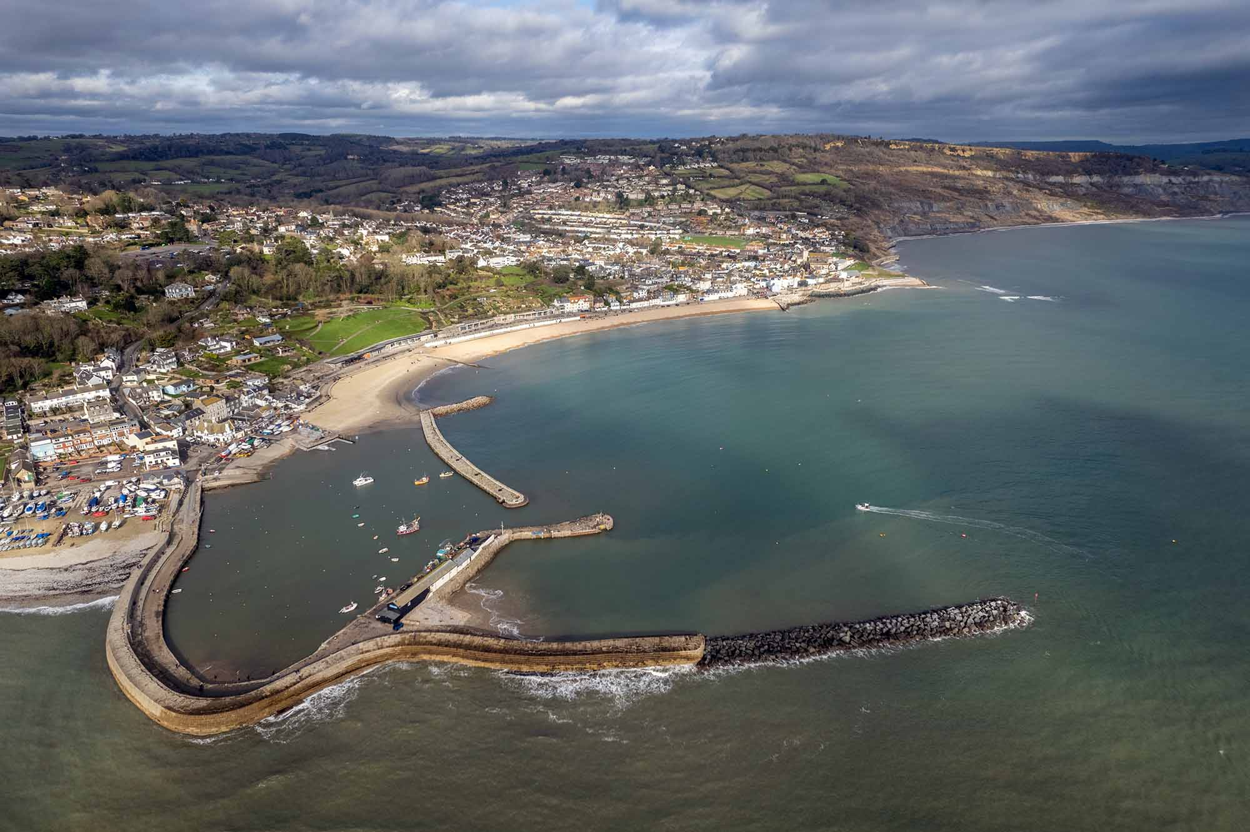
Coastal Management at Lyme Regis
Location and geology – Underline the correct word from those shown in bold below.
Lyme Regis is a small/large coastal town on the east/south coast of England/Wales. It lies on the eastern/western edge of the Dorset/Holderness Coast and forms part of the Jurassic/Cretaceous Coast, a World Heritage Site famous for its fossils and coastal/river landforms. The town is a popular tourist destination in the summer/winter.
The cliffs of Lyme Regis are made up of layers of hard rock (such as limestone/clay) over softer material (clays/granite).
Coastal Management – Study the statements below. Identify the reasons why coastal management was required at Lyme Regis.
 | Yes | No
The cliffs of Lyme Regis are particularly prone to landslides and slumping as they consist of layers of hard and soft rock.
Much of the town has been constructed on unstable cliffs, which experience some of the highest erosion rates in Europe due to high energy waves from the southwest and its geology.
Clay lies on limestone, so as the clay erodes, the cliffs are vulnerable to landslides.
Houses, roads and farmland are at risk of cliff landslides.
Tourist numbers were down due to the lack of beach material caused by coastal erosion.
Existing defences were destroyed by storms in 2014.
Annotate the image below to show the main features of coastal management at Lyme Regis.
Fill in the gaps to explain the effects and conflict
associated with Lyme Regis coastal management
1 | True or false? The geology of Lyme Regis consists of clay, which is vulnerable to erosion, lying on top of limestone, which is less vulnerable to erosion.
○ | A | True
○ | B | False
The beach front is more attractive due to ____________ and the wide promenade. This has led to increased ____________ numbers, and seafront ____________ are thriving. The new defences have withstood recent stormy___________. The harbour is better protected, benefiting the __________ industry and boat owners.
___________ have increased as ________ numbers have increased. For example, local people have experienced increased traffic __________ and litter due to increased tourism. Some feel the new coastal defences have spoilt the natural ________ landscape. The new defences may interfere with natural coastal __________ affecting neighbouring stretches of coastline, causing conflicts elsewhere. Stabilising cliffs that prevent _____________ will reduce the number of fossils found in the area.
tourist congestion nourishment businesses winters
fishing conflicts visitor coastal processes landslides
2 | Which of the following are examples of hard engineering solutions used at Lyme Regis?
○ | A | Wooden revetments
○ | B | Beach nourishment
○ | C | Rock armour
○ | D | Sea wall
3 | True or false? Coastal defences at Lyme Regis bring both positive and negative impacts.
○ | A | True
○ | B | False
4 | Identify two examples of conflicts resulting from coastal management in Lyme Regis.
○ | A | Tourists and locals due to increased traffic congestion due to greater visitor numbers.
○ | B | Famers downdrift of the defences and the local council due to increased erosion rates as less sediment is available to replace beach material.
○ | C | Fossil hunters and the local council due to the reduction in fossils as the cliffs are stabilised.

Slide 2
Coastal Management at Lyme Regis
Phase 1
Include, dates, management types, costs, diagrams
Phase 2
Include, dates, management types, costs, diagrams
Phase 3
Include, dates, management types, costs, diagrams
Phase 4
Include, dates, management types, costs, diagrams

