Slide 1
DT Summer Homework for Year 9 into 10
Bring your homework to your 1st DT lesson in September

Slide 2
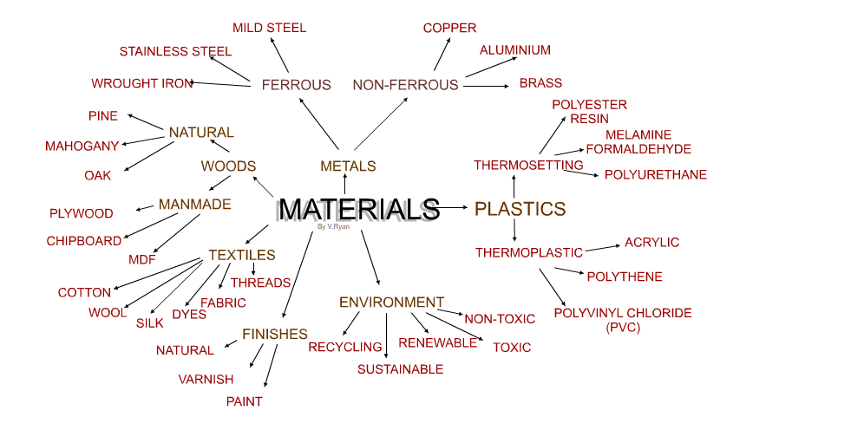
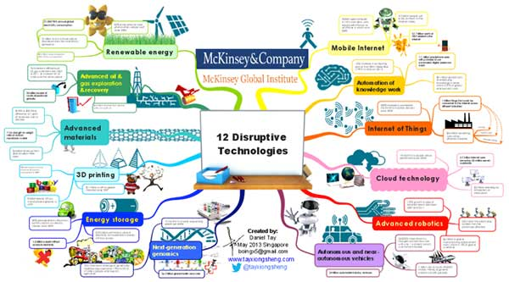
DT Summer Homework for Year 9 into 10
Create a visually effective Mind map on ‘Materials’:
Research different types of materials. Include the following: Papers and Boards, Metals, Polymers, Timbers (woods), Smart and Modern materials, Textiles,
Add thumbnail images to each material group
Suggested size is A3
Collect A3 paper from DT(E9,10 OR 11 before the summer holiday
Examples of Mind maps:
Useful links:
Introduction to Materials Research
13 Online Design Thinking Tools for Mind Mapping
Physical and working properties - Material categories and properties - AQA - GCSE Design and Technology Revision - AQA - BBC Bitesize
Example of content for your
Mind map-add printed images and drawings
Example of how to present your
Mind map-add printed images and drawings
(the example is for a different topic to yours)

